Slide 1
CODEBASIS RESUME PROJECT #13

Slide 2
GOODCABS’S PROJECT

Slide 3
PROBLEM STATEMENT
Domain: Transportation & Mobility Function: Operations
Goodcabs, a cab service company established two years ago, has gained a strong foothold in the Indian market by focusing on tier-2 cities. Unlike other cab service providers, Goodcabs is committed to supporting local drivers, helping them make a sustainable living in their hometowns while ensuring excellent service to passengers. With operations in ten tier-2 cities across India, Goodcabs has set ambitious performance targets for 2024 to drive growth and improve passenger satisfaction.
As part of this initiative, the Goodcabs management team aims to assess the company’s performance across key metrics, including trip volume, passenger satisfaction, repeat passenger rate, trip distribution, and the balance between new and repeat passengers.
However, the Chief of Operations, Bruce Haryali, wanted this immediately but the analytics manager Tony is engaged on another critical project. Tony decided to give this work to Peter Pandey who is the curious data analyst of Goodcabs. Since these insights will be directly reported to the Chief of Operations, Tony also provided some notes to Peter to support his work.

Slide 4
METRICS
Total Trips
Total Fare (Revenue)
Total Distance Travelled
Average Rating a. Passenger Rating b. Driver Rating
Average Fare per Trip (Average Trip Cost)
Average Fare per Km
Average Trip Distance
Trip Distance (Max, Min)
Trip Type: a. New Trips b. Repeated Trips
Total Passengers
New Passengers
Repeat Passengers
New vs. Repeated Passenger Trips Ratio
Repeat Passenger Rate (%)

Slide 5
Database Overview
Data Model Overview
Dimension Table –
dim_city -
dim_date
Fact Table –
fact_passenger_summary
dim_repeat_trip_distribution
fact_trips
city_target_passenger_rating
monthly_target_new_passengers
monthly_target_trips

Slide 6
Question to Solve
Top 3 City by Total Trips.
Bottom 3 City by Total Trips
Average Fare Per Trip by City
Peak and Low Demand Month by City
Weekend vs WeekDay Demand Trip by City
Repeat Passenger Frequency and City Contribution Analysis
Fare Distribution Across City
Peak and Low Demand Month by Revenue
Average Rating by City and Passenger
City Wise Rating

Slide 7
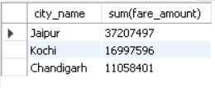
Question 1
We Can see that Top 3 City are Jaipur ,Kochi and Chandigarh , We can Increase revenue more in this by hiring more drives , doing promotions , offers discount .

Slide 8

Question 2
We Can see that Bottom 3 City are Coimbatore, Vadodara and Mysore, We can Fix Issue this issue by doing cost optimization , ride safety , tailoring the offerings.

Slide 9


Question 3
AvgFareTrip and Avg Distance are highest in Jaipur and Kochi and Surat and Vadodara is not doing good in this.

Slide 10
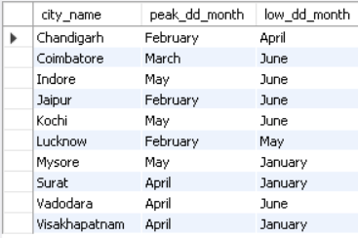
Question 4
Peak Month for Vishakhapatnam, Vadodara, Surat is April
Peak Month for Mysore Kochi Indore is May
Peak Month for Lucknow, Jaipur , Chandigarh is February
Peak Month for Coimbatore is March
Low Month for Vishakhapatnam, Mysore, Surat is January
Low Month for Vadodara , Jaipur Kochi Indore, Coimbatore is June
Low Month for Lucknow May
Low Month for Chandigarh is April

Slide 11
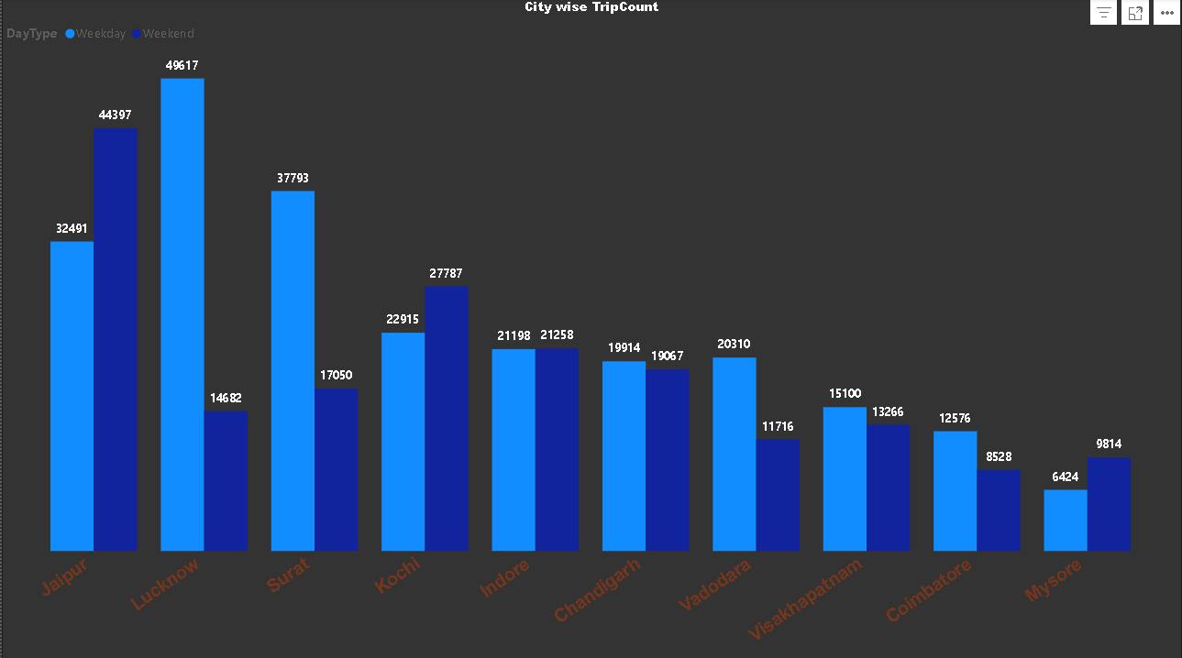
Question 5
Lucknow is Highest in Weekday
Mysore is Lowest in Weekday
Jaipur is Highest in Weekend
Coimbatore is Lowest on Weekend

Slide 12
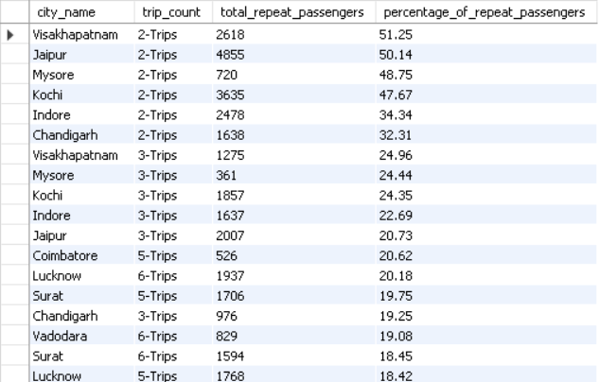
Question 6

Slide 13
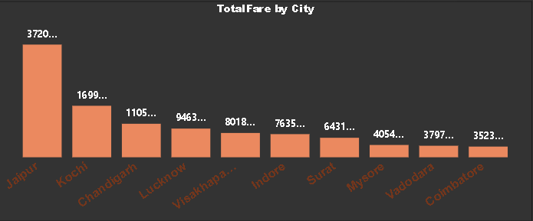
Question 7

Slide 14
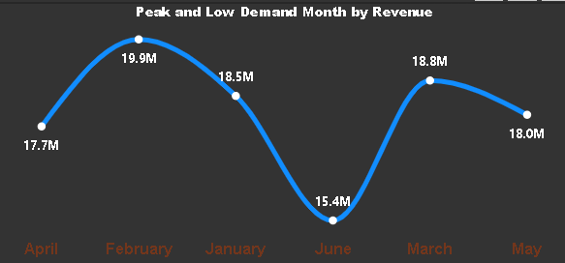
Question 8

Slide 15
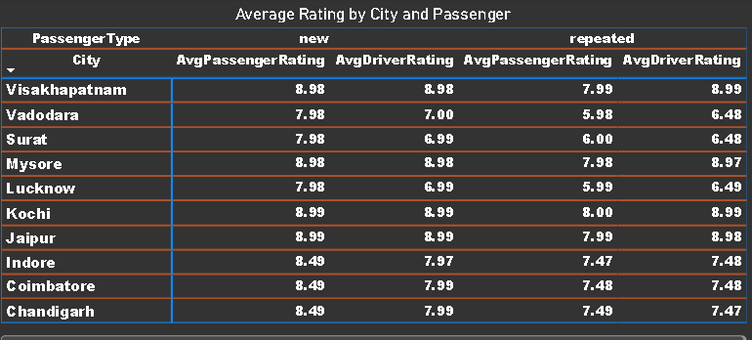
Question 9

Slide 16
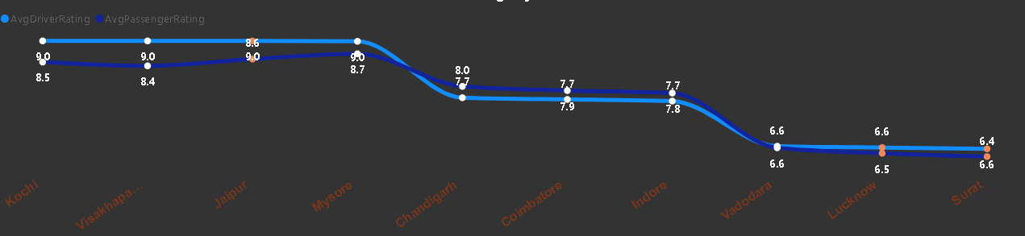
Question 10

Slide 17
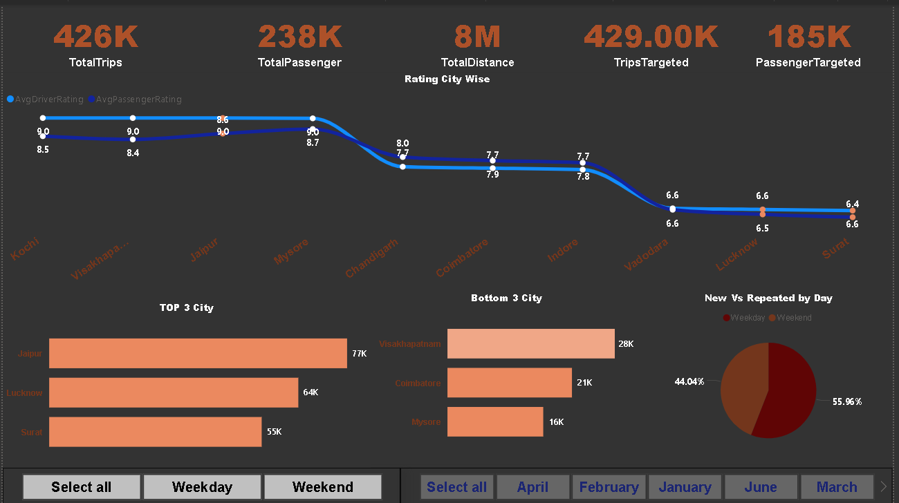
Dashboard 1

Slide 18
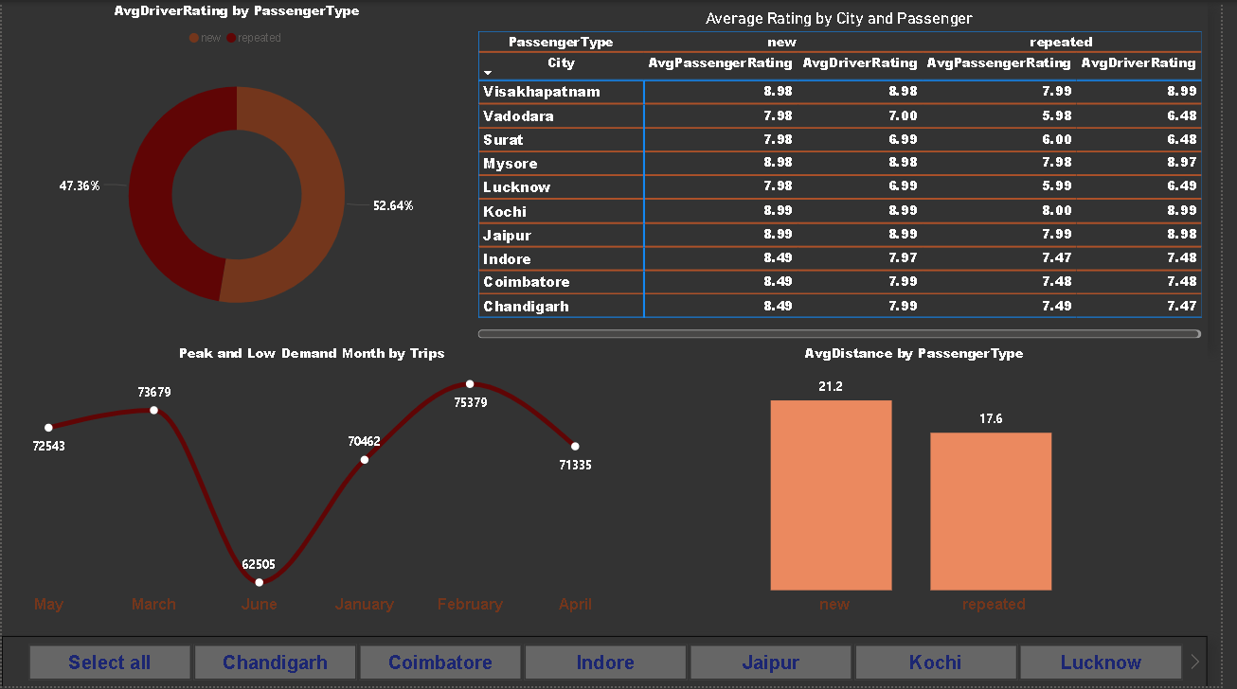
Dashboard 2

Slide 19
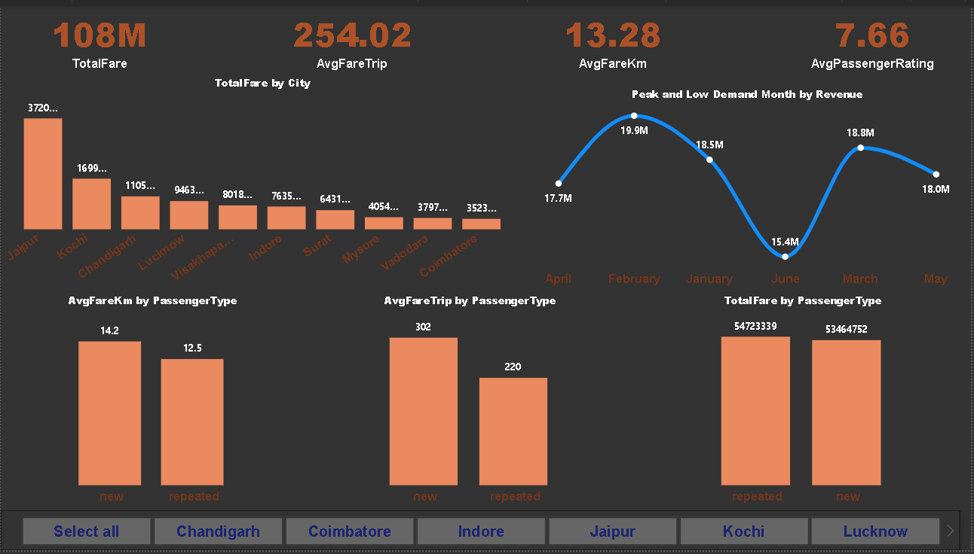
Dashboard 3

Slide 20
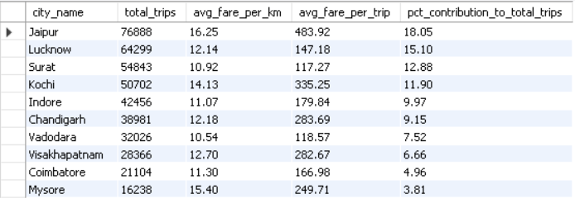
Business Request
Request 1 – City Level Fare and Trip Summary Report

Slide 21
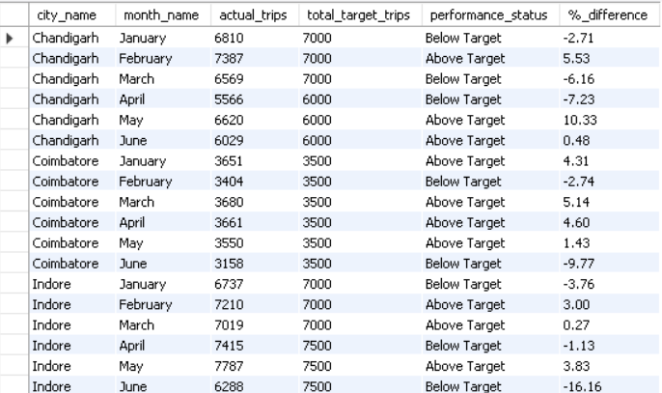
Business Request
Request 2 – Monthly City Level Trip Target Performance Report

Slide 22
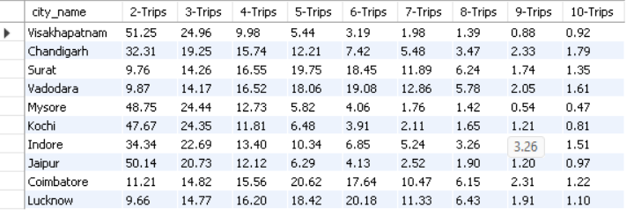
Business Request
Request 3 – City Level Repeat Passenger Trip Freq Report

Slide 23
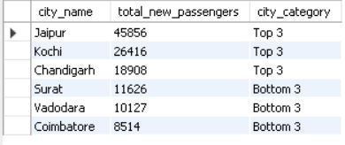
Business Request
Request 4 – Identify Cities with Highest and Lowest Total New Passenger

Slide 24
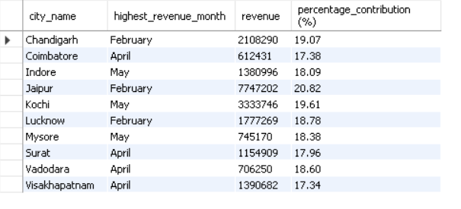
Business Request
Request 5 – Identify Month with Highest Revenue for each City

Slide 25
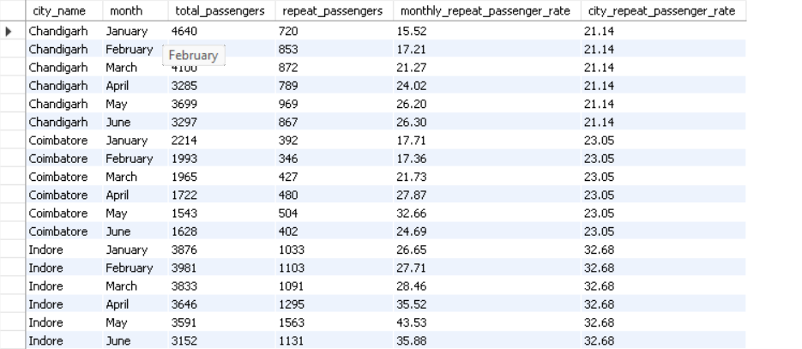
Business Request
Request 6 – Repeat Passenger Rate Analysis

